Slide 1
An Analysis of the ClimActor v2 Dataset
By Mary Mungai

Slide 2
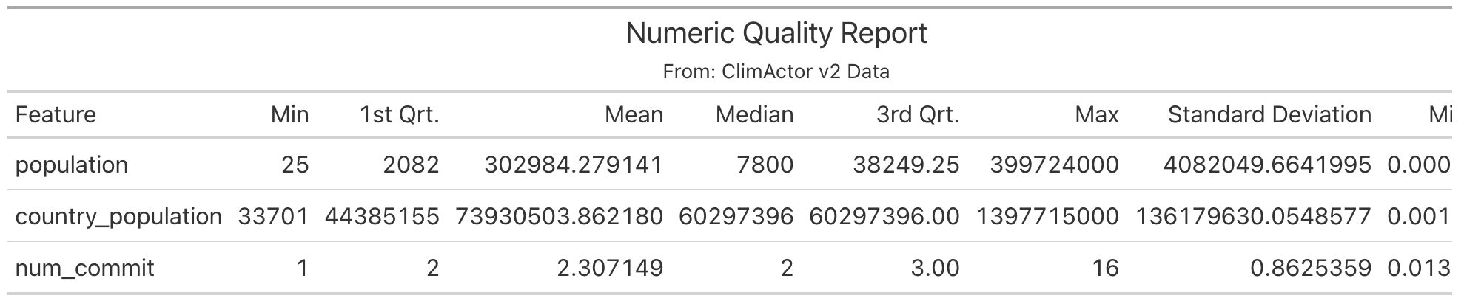
Data Quality Report P.1
Numeric Data
This data quality report was run on a merged data set of the key dict, subnationals context and countries data sets, using the sub-national entity name and climactor_id as the id variables. This data quality report shows there are some large standard deviation values for population and country population, and all variables seem to be heavily left-skewed.
There were some notable errors during merging: 4 observations did not have a one-to-one match during the first and second merges, and the merged data set needs to undergo de-duplication.
Some ideas for potential updates include match the identifier variables across all three data sets, such as labeling them all as “name”.

Slide 3
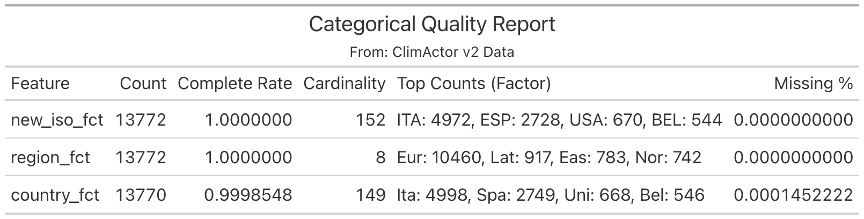
Data Quality Report P.2
Categorical Data
This data quality report was run on the same merged data set. This report is even more useful than the numeric quality report because it shows there is a large disparity of sub-national actors with climate commitments: there are almost twice the number of sub-national actors in Italy than Spain, which has almost four times as many actors as those in the United States and Belgium.
This report also shows that ISO and country name can be almost matched one-to-one. This information can be used to improve dataset searchability for updating purposes. The ISO value can be used in the countries data set as a unique identifier, which could be especially useful for countries that have similar names (e.g., Niger and Nigeria).

Slide 4
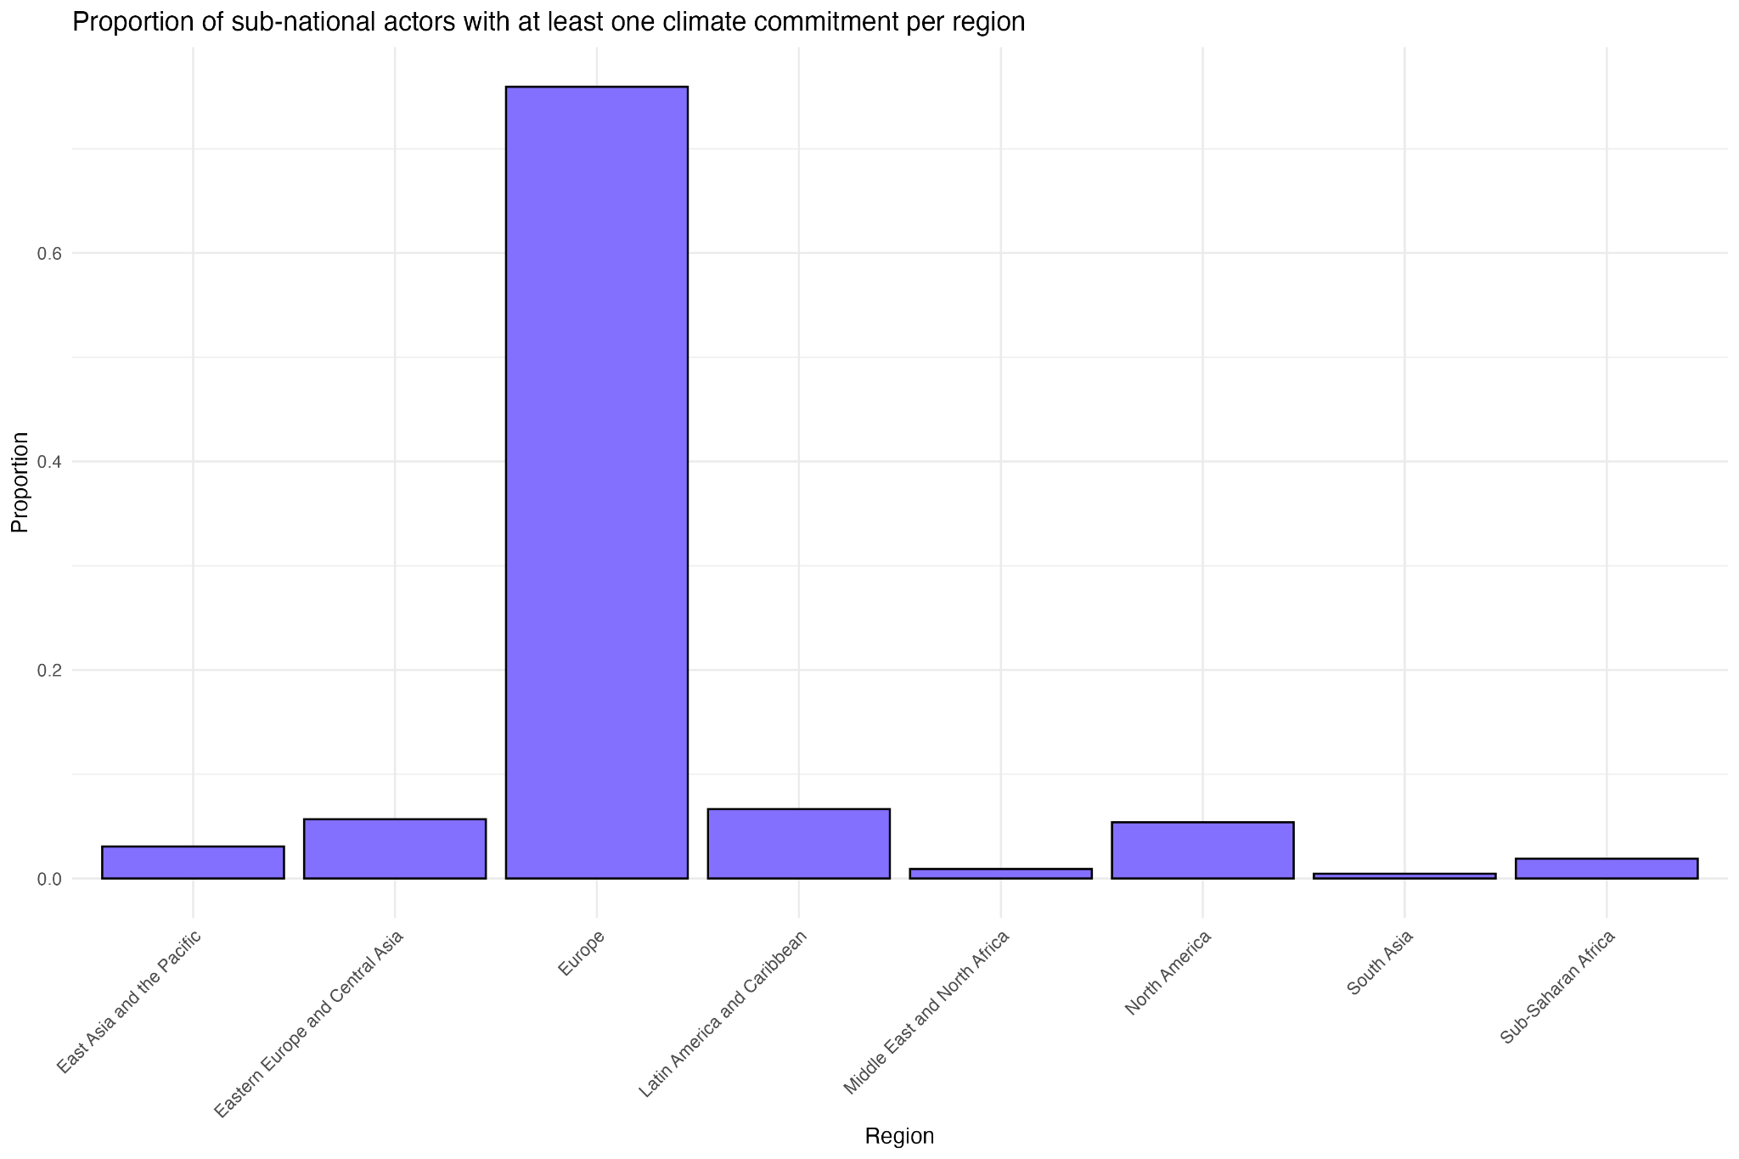
Proportion of observations per region
Bar Plot
Goal of the ClimActor v.2 Dataset
To: 1) track climate commitments from sub-national actors, 2) help other researchers integrate external data with ClimActor data 3) expand to integrate other sub-national actors
Why Region?
The countries data set contains useful information about the areas in which we have good data on. Making note of this might be helpful for future updating purposes, as it’s not clear whether the overrepresentation of Europe in the data is a data quality issue or solely a reflection of the true number of sub-national climate-committed actors.
Impact
This bar plot confirms the trend we suspected from the categorical data quality report: there are more sub-national actors from Europe than anywhere else, as sub-national actors in Europe make up more than 70% of the data set.

Slide 5
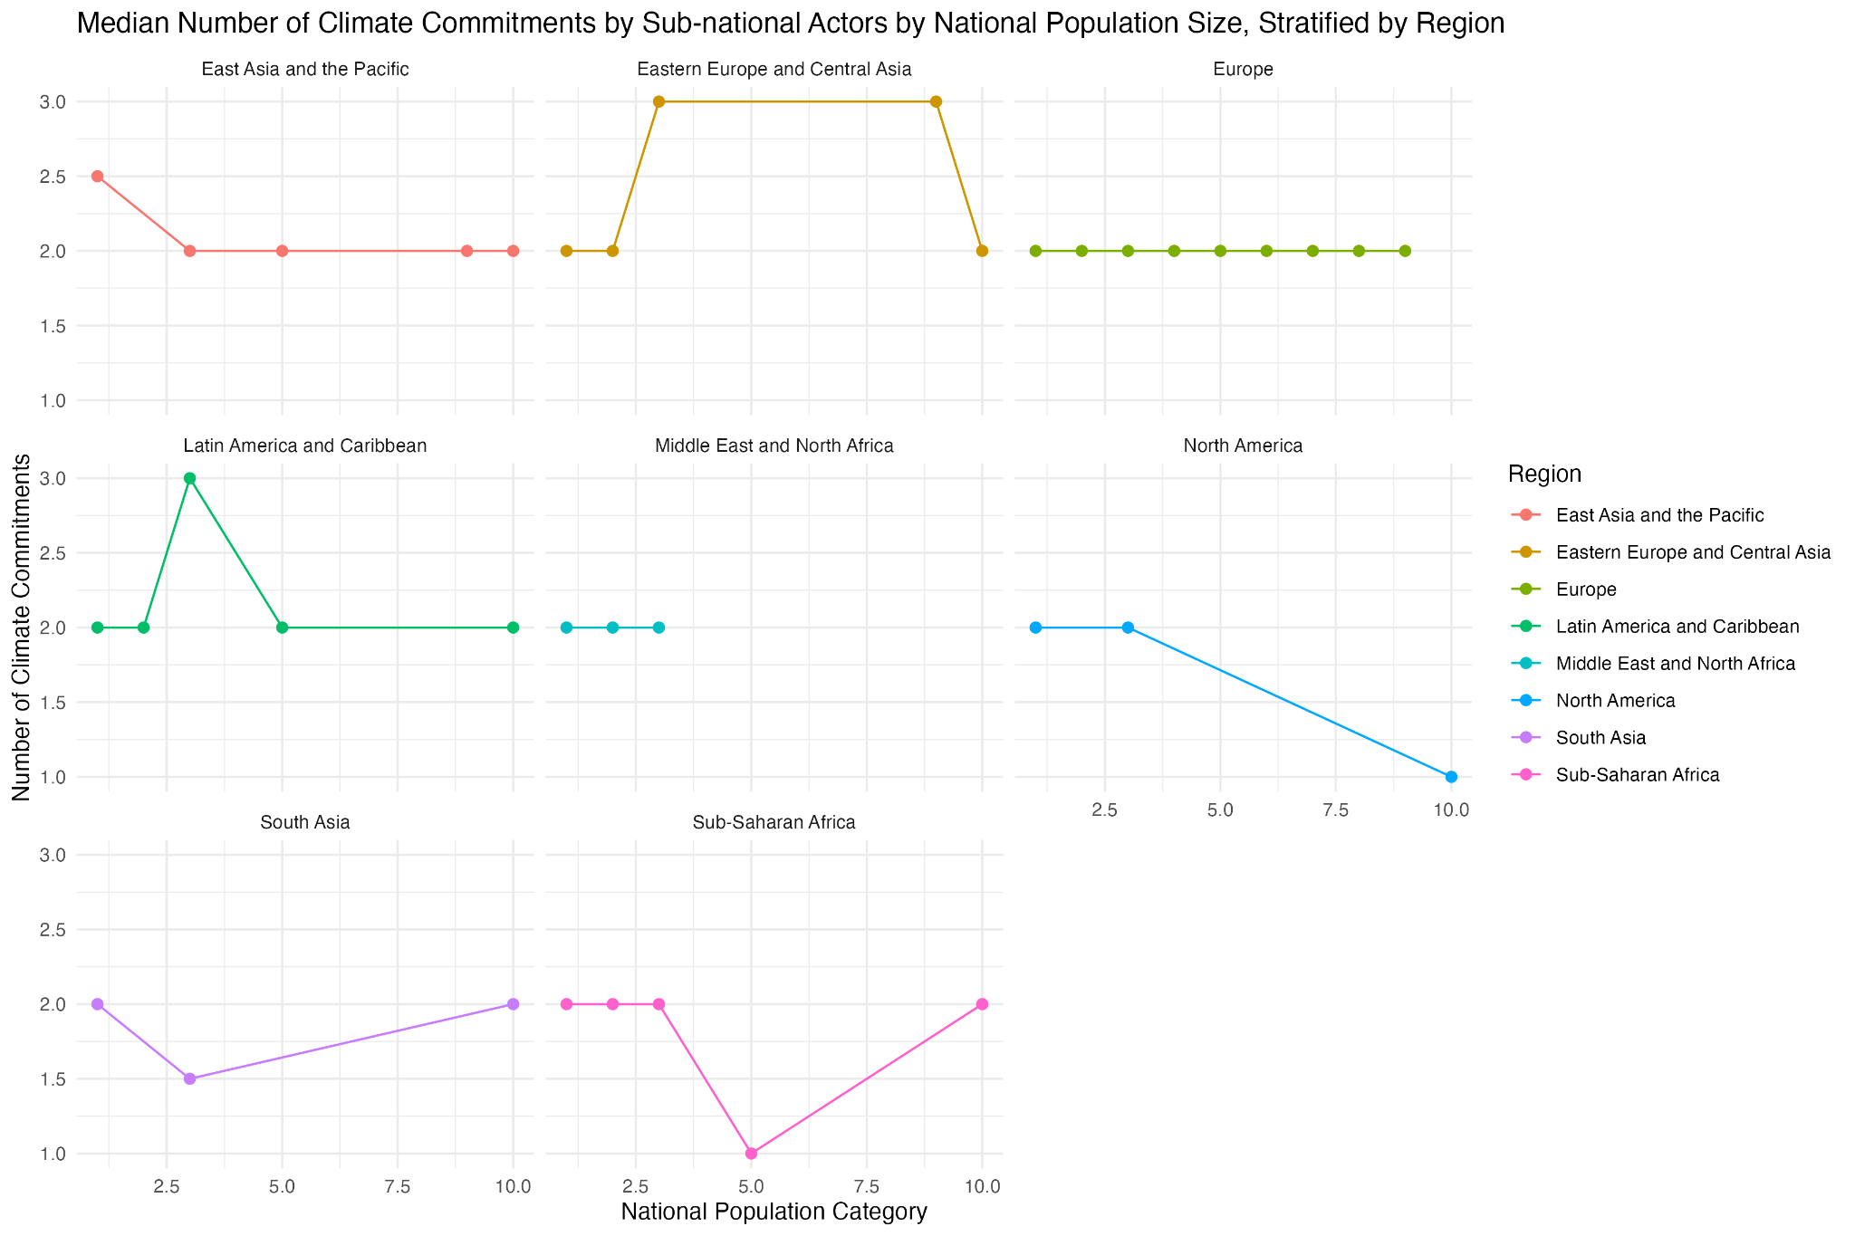
Median commitments per population category and region
Line Graph
Why Population Size?
The presence of sub-national actors doesn’t alone indicate climate commitments. The number of climate commitments made might be a more robust measure of commitment, and one that may not vary much with population size, unlike the number of sub-national actors. There are outliers in both number of climate commitments and national populations., so stratifying the actors into deciles based on relative population size might be more impactful.
Impact
Sub-national actors in higher population nations in North America have lower median climate commitments compared to actors in lower population nations on the continent.
Other regions have median climate commitment spikes at mid-population percentiles, both positively (Latin America and Eastern Europe/Central Asia) and negatively (South Asia and Sub-Saharan Africa).

Slide 6
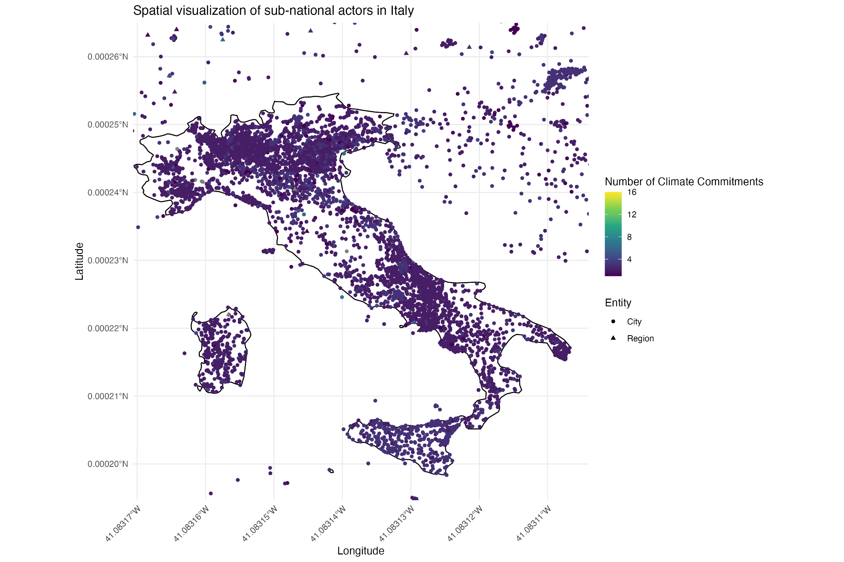
Spatial distribution of sub-national actors
Map
Why Italy?
It is the country with the largest number of climate-committed sub-national actors at 4,972, and also the country whose population of 60,297,396 people is the exact median of the data set. A mid-sized nation with the highest number of observations makes for an interesting case study in where and to what extent sub-national actors are committing to climate policies.
Impact
The map of Italy is cleared very dense, especially at the north east and central west region. It seems that there are many sub-national actors which have committed to 4 or fewer different climate commitments, and another handful that have committed 8 or fewer climate commitments.

